Slide 1


Slide 2

Conceptos
Cuando hay big data?
2
Bases de Datos NoSQL
3
Categorias y ejemplos
Diferencias con RDBMS
3 V’s
Teorema CAP
4
Que es Big Data?
1

Slide 3
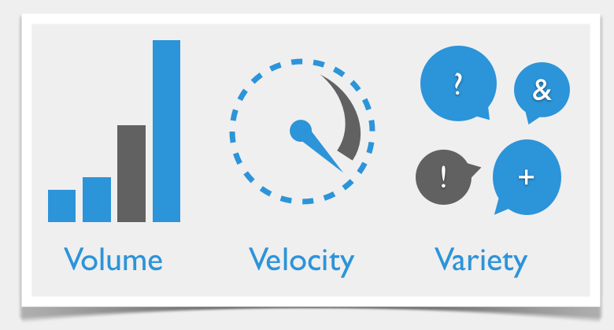
Big Data – 3 V’s
Notes:
Que sirgnifica cada sigla
Volume refers to the amount of data, variety refers to the number of types ofdata and velocity refers to the speed of data processing.

Slide 4
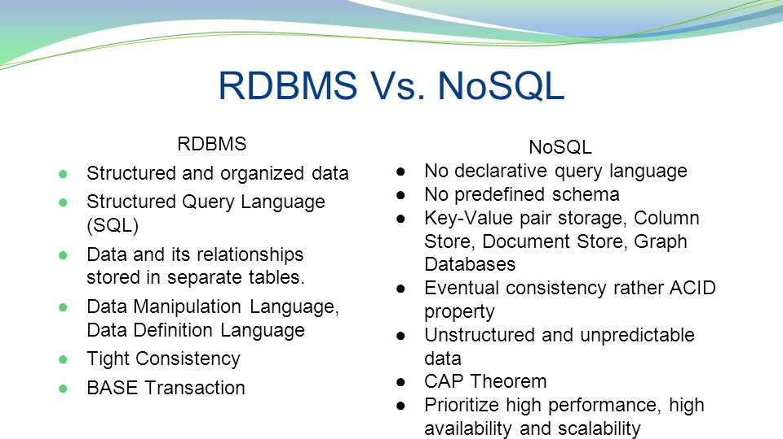
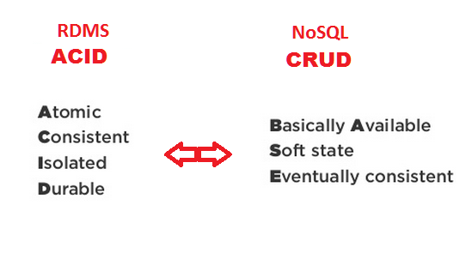
RDMS vs NoSQL
Notes:
- SQL databases are vertically scalable whereas the NoSQL databases are horizontally scalable. SQL databases are scaled by increasing the horse-power of the hardware. NoSQL databases are scaled by increasing the databases servers in the pool of resources to reduce the load.
SQL: It sticks to ACID principles (atomicity, consistency, isolation, durability), thus guaranteeing stability, security, and predictability both of the entire database and every transaction in particular.
NoSQL: It has been primarily developed to address the scalability problem characteristic of SQL. As a result, it is schema-free and built on distributed systems, which makes it easy to scale and shard.
However, these benefits come at the cost of relaxing ACID principles: instead of keeping all four parameters consistent throughout every transaction, NoSQL uses the principle of eventual consistency. This means that if there are no new updates for a particular data item for a certain period of time, eventually all accesses to it will return the last updated value. That’s why such systems are usually described as providing BASE guarantees (Basically Available, Soft state, Eventual consistency) — as opposed to ACID.
---
Atomic: Everything in a transaction succeeds or the entire transaction is rolled back.
Consistent: A transaction cannot leave the database in an inconsistent state.
Isolated: Transactions cannot interfere with each other.
Durable: Completed transactions persist, even when servers restart etc.
---
Basically available could refer to the perceived availability of the data. If a single node fails, part of the data won't be available, but the entire data layer stays operational.
Update: deducing from Mau's answer, could it mean the entire data layer is always accepting new data, i.e. there are no locking scenarios that prevent data from being inserted immediately?
Soft state: All I could find was the concept of data needing a period refresh. Without a refresh, the data will expire or be deleted.
Automatic deletion of data in a database seems strange to me.
Expired or stale data makes more sense. But this concept would apply to any type of redundant data storage, not just NoSQL. Does it describe something else then?
Eventual consistency means that updates will eventually ripple through to all servers, given enough time.
"eventual consistency" in which database changes are propagated to all nodes "eventually" (typically within milliseconds) so queries for data might not return updated data immediately or might result in reading data that is not accurate, a problem known as stale reads
--
Basically available indicates that the system it is mostly available but the servers might go down for various reasons
Soft state indicates that the state of the system may change over time, even without input. This is because of the eventual consistency model.
Eventual consistency indicates that the system will become consistent over time, given that the system doesn't receive input during that time.

Slide 5
When to use each
REASONS TO USE A SQL DATABASE
REASONS TO USE A NOSQL DATABASE
You need to ensure ACID compliancy (Atomicity, Consistency, Isolation, Durability).
ACID compliancy reduces anomalies and protects the integrity of your database by prescribing exactly how transactions interact with the database.
Your data is structured and unchanging
Storing large volumes of data that often have little to no structure.
Making the most of cloud computing and storage. Cloud-based storage is an excellent cost-saving solution, but requires data to be easily spread across multiple servers to scale up. Using commodity (affordable, smaller) hardware on-site or in the cloud saves you the hassle of additional software
Rapid development.

Slide 6
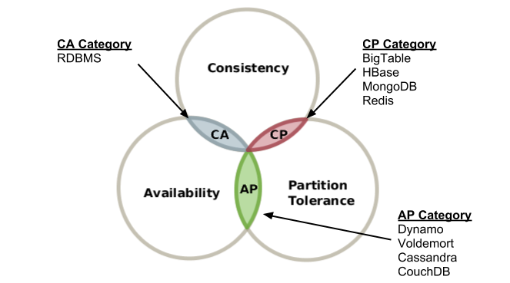
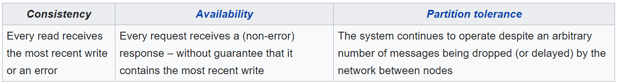
Big Data – Teorema CAP
Notes:
In other words, the CAP theorem states that in the presence of a network partition, one has to choose between consistency and availability.
No distributed system is safe from network failures, thus network partitioning generally has to be tolerated. In the presence of a partition, one is then left with two options: consistency or availability. When choosing consistency over availability, the system will return an error or a time-out if particular information cannot be guaranteed to be up to date due to network partitioning. When choosing availability over consistency, the system will always process the query and try to return the most recent available version of the information, even if it cannot guarantee it is up to date due to network partitioning.
Que bd hay en cada vertice

Slide 7
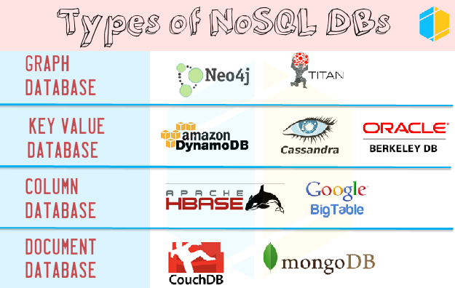
Big Data - NoSQL
Notes:
Diferencias – pros / contras / casos uso de cada una + ejemplos
Key-value model—the least complex NoSQL option, which stores data in a schema-less way that consists of indexed keys and values. Examples: Cassandra, Azure, LevelDB, and Riak.
Column store—or, wide-column store, which stores data tables as columns rather than rows. It’s more than just an inverted table—sectioning out columns allows for excellent scalability and high performance. Examples: HBase, BigTable, HyperTable.
Document database—taking the key-value concept and adding more complexity, each document in this type of database has its own data, and its own unique key, which is used to retrieve it. It’s a great option for storing, retrieving and managing data that’s document-oriented but still somewhat structured. Examples: MongoDB, CouchDB.
Graph database—have data that’s interconnected and best represented as a graph? This method is capable of lots of complexity. Examples: Polyglot, Neo4J.

Slide 8
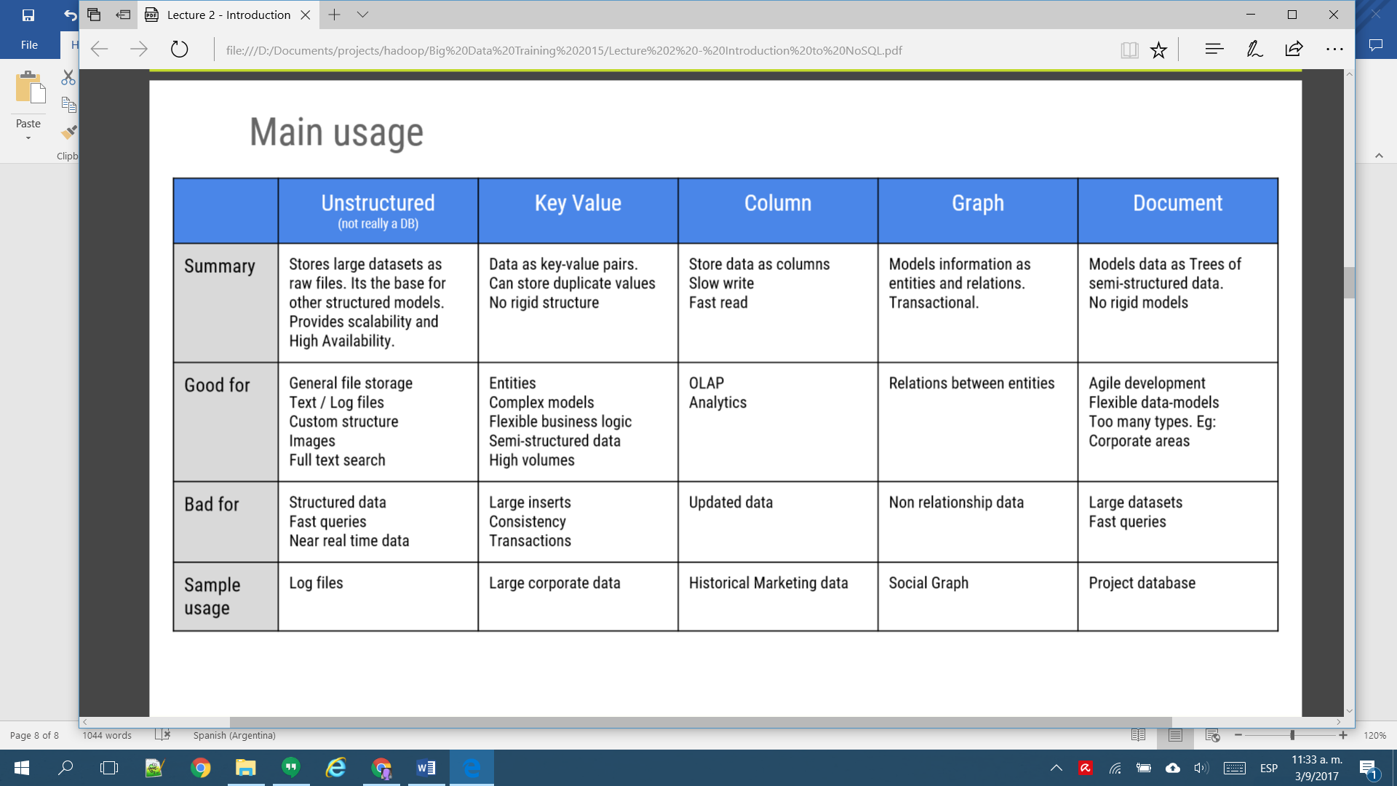
NoSQL categories

Slide 9
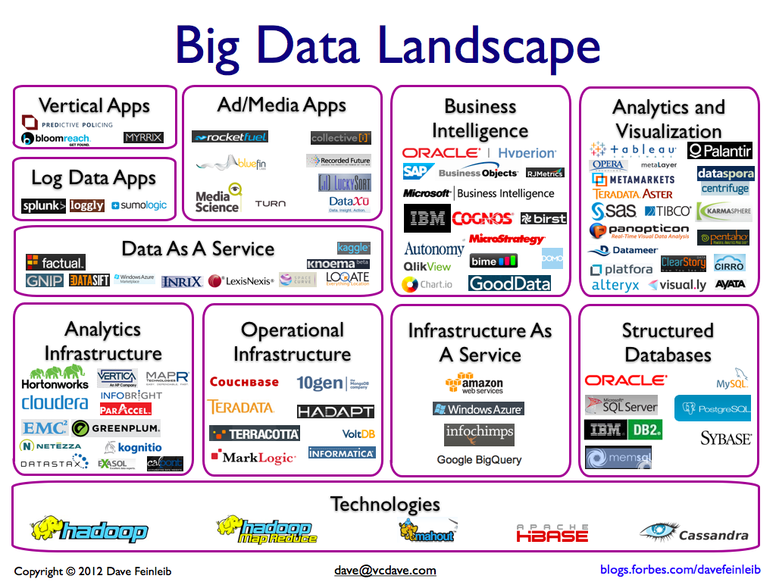
Notes:
Ambari – A web-based tool for provisioning, managing, and monitoring Apache Hadoop clusters which includes support for Hadoop HDFS, Hadoop MapReduce, Hive, HCatalog, HBase, ZooKeeper, Oozie, Pig, and Sqoop.
Avro – A data serialization system.
Cassandra – A scalable multi-master database with no single points of failure.
Chukwa – A data collection system for managing large distributed systems.
Impala – The open source, native analytic database for Apache Hadoop. Impala is shipped by Cloudera, MapR, Oracle, and Amazon.
Flume – A distributed, reliable, and available service for efficiently collecting, aggregating, and moving large amounts of streaming event data.
Kafka – A messaging broker that is often used in place of traditional brokers in the Hadoop environment because it is designed for higher throughput and provides replication and greater fault tolerance.
Mahout – A scalable machine learning and data mining library.
Tajo – A robust big data relational and distributed data warehouse system for Apache Hadoop. Tajo is designed for low-latency and scalable ad-hoc queries, online aggregation, and ETL on large-data sets stored on HDFS and other data sources. By supporting SQL standards and leveraging advanced database techniques, Tajo allows direct control of distributed execution and data flow across a variety of query evaluation strategies and optimization opportunities.
Tez – A generalized data-flow programming framework, built on Hadoop YARN, which provides a powerful and flexible engine to execute an arbitrary DAG of tasks to process data for both batch and interactive use-cases. Tez is being adopted by Hive, Pig and other frameworks in the Hadoop ecosystem, and also by other commercial software (e.g. ETL tools), to replace MapReduce as the underlying execution engine.
Zookeper – A high-performance coordination service for distributed applications.

Slide 10

Apache Hadoop

Slide 11

Apache Hadoop
Que es / Casos de uso
Caracteristicas
Componentes
Landscape
Diferencias Hadoop 1 vs Hadoop 2
Cuando no usar Hadoop
Notes:
Apache Hadoop es un framework de software que soporta aplicaciones distribuidas bajo una licencia libre.¹​ Permite a las aplicaciones trabajar con miles de nodos y petabytes de datos. Hadoop se inspiró en los documentos Google para MapReduce y Google File System (GFS).
• Alta escalabilidad • Procesamiento paralelo • Baja latencia • Datos no estructurados y estructurados • NoSQL
Tecnología altamente escalable: Un clúster de Hadoop puede crecer simplemente añadiendo nuevos nodos. No es necesario hacer ajustes que modifiquen la estructura incicial. Por lo tanto, nos permite un crecimiento fácil, sin estar atados a las características iniciales del diseño, haciendo uso de decenas de servidores de abajo costo que, a diferencia de la base de datos relacional, no puede escalar. Gracias al procesamiento distribuido de MapReduce, los archivos se dividen en bloques de forma sencilla.
Almacenamiento a bajo costo: La informacion no se almacena de forma predefinida, en filas y columnas, como ocurre con las bases de datos tradicionales, sino que Hadoop asigna datos categorizados a través de miles de computadoras baratas, y ello supone un gran ahorro. Sólo así se convierte en factible. De otro modo, no podríamos trabajar con grandes volúmenes de datos, pues el costo sería altísimo, inasumible para la gran mayoría de las empresas.
Flexibilidad: Al incrementar el número de nodos del sistema también ganamos en capacidad de almacenamiento y procesamiento. A su vez, es posible agregar o acceder a nuevas ydiferentes fuentes de datos (estructurados, semiestructurados y no estructurados), al tiempo que existe la posibilidad de adaptar herramientas accesorias que funcionan en el entorno Hadoop y ayudan en el diseño de procesos, la integración o mejorar otros aspectos.
Velocidad: De poco nos servirán su bajo coste, escalabilidad y flexibilidad si el resultado no es razonablemente rápido. Afortunadamente, Hadoop también permite ejecutar procesamientos y realizar análisis muy rápidos.
Tolerante a fallos: Hadoop es una tecnología que facilita almacenar grandes volúmenes de información, lo que a su vez permite recuperar datos de forma segura. Si un equipo se cae, siempre hay otra copia disponible, con lo que es posible la recuperación de datos en caso de producirse fallos.
Hadoop Architecture distributes data across the cluster nodes by splitting it into small blocks (64 MB or 128 MB depending upon the configurations). Every node tries to work on individual block stored locally. Hence no data transfer is required during the processing most of the time.
Every time when Hadoop process the data, each node connects to other node as much less as possible. So most of the time node only deals with the data which is stored locally. This concept is known as “Data Locality”.
As we know data is distributed across the nodes, so in order to increase data availability each block of the data is replicated (as per the configuration) over different nodes. This method would help Hadoop to handle partial failures in the cluster.
Whenever MapReduce job (consist to typically two tasks Map Task and Reduce Task) is executed, Map tasks are executed on individual data blocks on each node (in most of the cases) and leverage “Data Locality”. This is how multiple nodes process data in parallel manner. It makes processing faster than traditional distributed systems. I’ll Explain you MapReduce in my upcoming posts.
If any node fails in between, the master will detect this failure and assign the same task to another node where the replica of the same data block is available.
If any failed node restarts, it automatically joins back to the cluster and than after master can assign it a new task whenever is required.
In the execution process of any job, if master detects any task running slowly on any node compare to other nodes, it will allocate the same redundant task on other node to make overall execution faster. This process is known as “Speculative Execution“
The Hadoop jobs are written in a high level language like Java and Python, and the developer do not have any control over network programming or component level programming. You just have to focus on core logic other things would be taken care by Hadoop framework itself.

Slide 12
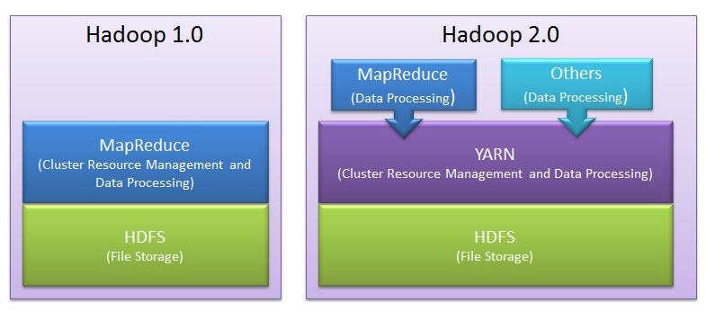
Hadoop

Slide 13
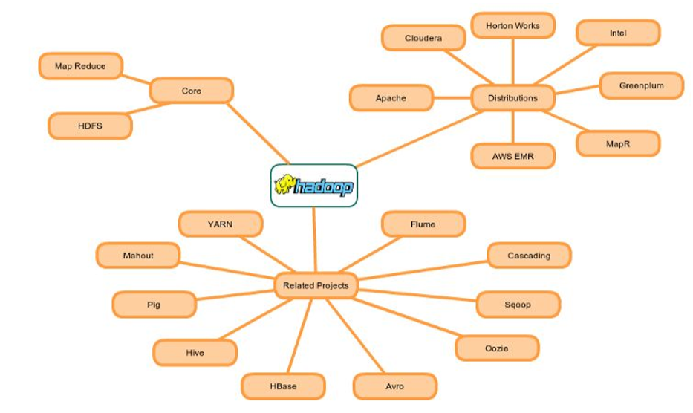

Slide 14
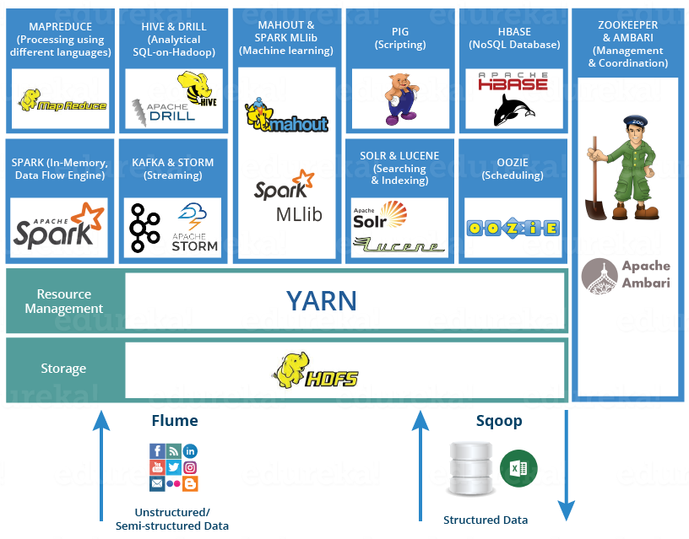
Hadoop Ecosystem

Slide 15
Hadoop1 | Hadoop2
Supports MapReduce (MR) processing model only. Does not support non-MR tools | Allows to work in MR as well as other distributed computing models like Spark, Hama, Giraph, Message Passing Interface) MPI & HBase coprocessors.
MR does both processing and cluster-resource management. | YARN (Yet Another Resource Negotiator) does cluster resource management and processing is done using different processing models.
Has limited scaling of nodes. Limited to 4000 nodes per cluster | Has better scalability. Scalable up to 10000 nodes per cluster
Works on concepts of slots – slots can run either a Map task or a Reduce task only. | Works on concepts of containers. Using containers can run generic tasks.
A single Namenode to manage the entire namespace. | Multiple Namenode servers manage multiple namespaces.
Has Single-Point-of-Failure (SPOF) – because of single Namenode- and in the case of Namenode failure, needs manual intervention to overcome. | Has to feature to overcome SPOF with a standby Namenode and in the case of Namenode failure, it is configured for automatic recovery.
MR API is compatible with Hadoop1x. A program written in Hadoop1 executes in Hadoop1x without any additional files. | MR API requires additional files for a program written in Hadoop1x to execute in Hadoop2x.
Has a limitation to serve as a platform for event processing, streaming and real-time operations. | Can serve as a platform for a wide variety of data analytics-possible to run event processing, streaming and real-time operations.
A Namenode failure affects the stack. | The Hadoop stack – Hive, Pig, HBase etc. are all equipped to handle Namenode failure.
Does not support Microsoft Windows | Added support for Microsoft windows
Notes:
Hadoop 2.x has some common Hadoop API which can easily be integrated with any third party applications to work with Hadoop
It has some new Java APIs and features in HDFS and MapReduce which are known as HDFS2 and MR2 respectively
New architecture has added the architectural features like HDFS High Availability and HDFS Federation
Hadoop 2.x not using Job Tracker and Task Tracker daemons for resource management now on-wards, it is using YARN (Yet Another Resource Negotiator) for Resource Management

Slide 16
Hadoop not good for
1. Low-latency Data Access
Applications that require real-time query, and low-latency access to data in tens of milliseconds will not work well with Hadoop.
Hadoop is not a substitute for a database. Database index records that will gains low-latency and fast response.
But if you really want to replace the database for real time needs, try HBase, which is a column-oriented database for random and real time read/write.
2. Structured Data
Hadoop is not fit for structured data with strong relationship. Hadoop works well for semi-structured and unstructured data. It stores data in files, doesn’t index them like RDBMS. Therefore, each ad hoc query for Hadoop is processed by MapReduce job which will bring the latency cost.
3. When data isn’t that big
How big the data is big enough for Hadoop? The answer is TB or PB. When your analytics data is only tens of GB, Hadoop is heavy. Don’t follow the fashion and use Hadoop, just follow your requirements.
4. Too many small files
When there are too many small files, the NameNode will hit its memory limit where the block map and the metadata are hosted. And to handle the NameNode bottleneck, Hadoop introduces HDFS Federation.
5. MapReduce may not the best choice
MapReduce is a simple programming model in parallel. But for MapReduce parallelism, you need to make sure each MR job and the data where the job runs on is independent from all the others. Every MR shouldn’t have dependencies.
But if you want to do some data sharing during MR, you can do like this:
- Iteration: run multiple MR jobs, with the output of one being the input of the next MR.
- Shared state information. But don’t share information in memory, since each MR job is run on single JVM.

Slide 17

Map Reduce
Notes:
MapReduce es un proceso batch, creado para el proceso distribuido de los datos. Permite de una forma simple, paralelizar trabajo sobre los grandes volúmenes de datos, como combinar web logs con los datos relacionales de una base de datos OLTP, de esta forma ver como los usuarios interactúan con el website.
El modelo de MapReduce simplifica el procesamiento en paralelo, abstrayéndonos de la complejidad que hay en los sistemas distribuidos. Básicamente las funciones Map transforman un conjunto de datos a un número de pares key/value. Cada uno de estos elementos se encontrará ordenado por su clave, y la función reduce es usada para combinar los valores (con la misma clave) en un mismo resultado.
Un programa en MapReduce, se suele conocer como Job, la ejecución de un Job empieza cuando el cliente manda la configuración de Job al JobTracker, esta configuración especifica las funciones Map, Combine (shuttle) y Reduce, además de la entrada y salida de los datos.

Slide 18
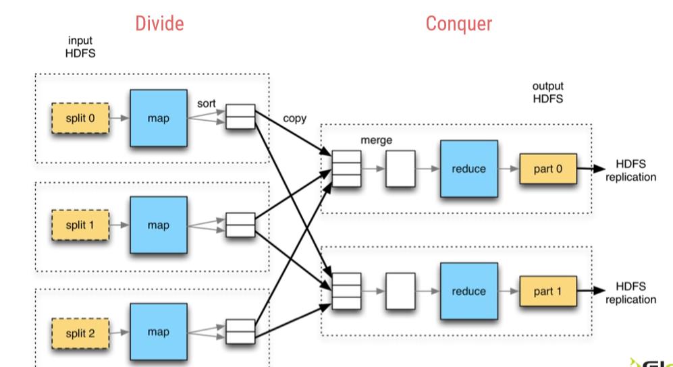
Notes:
Each of these tasks would run on individual blocks of the data
First mapper task would take each line of elements as an input and generates intermediate key value pairs
Each mapper task is executed on a single block of data
Than reducer task will take list of key value pairs for same keys, process the data and generates the final output
A phase called shuffle and sort will take place between mapper and reducer task will send the data to proper reducer tasks
Shuffle process maps the mapper output with the same key to the collection of values as a value
For example (key1, val1) and (key1, val2) will be converted to (key1, [val1, val2])
The mapper and reducer tasks would in parallel
The reducer tasks can start their word as soon as mapper tasks are completed

Slide 19

HDFS

Slide 20
Highly Distributed File System
HDFS
Que es?
Componentes
Namenode
Como funciona?
Arquitectura
Datanode
Componentes y funciones
Concepto bloque
Secondary Namenode
Problemas
SPOF → HDFS HA – Standby NN
NN RAM & blocks → HDFS Federation
Proceso
Write data
Read data

Slide 21
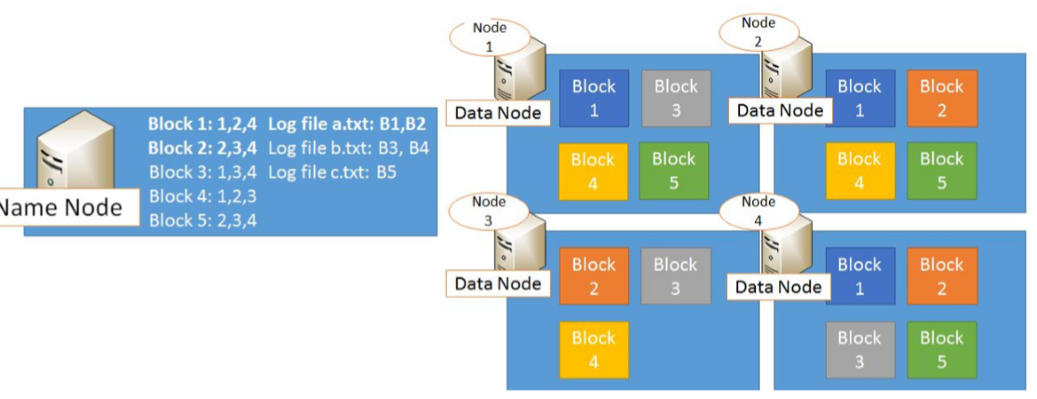
HDFS
Notes:
Single Point Of Failure: As per above description, HDFS has only one Name Node so if that process or machine goes down complete cluster goes down. That is why Name Node in Hadoop 1.x is considered to be a Single Point of Failure.
Blocks are the nothing but the smallest continuous location on your hard drive where data is stored. In general, in any of the File System, you store the data as a collection of blocks. Similarly, HDFS stores each file as blocks which are scattered throughout the Apache Hadoop cluster. The default size of each block is 128 MB in Apache Hadoop 2.x (64 MB in Apache Hadoop 1.x) which you can configure as per your requirement.
It is not necessary that in HDFS, each file is stored in exact multiple of the configured block size (128 MB, 256 MB etc.). Let’s take an example where I have a file “example.txt” of size 514 MB as shown in above figure. Suppose that we are using the default configuration of block size, which is 128 MB. Then, how many blocks will be created? 5, Right. The first four blocks will be of 128 MB. But, the last block will be of 2 MB size only.

Slide 22
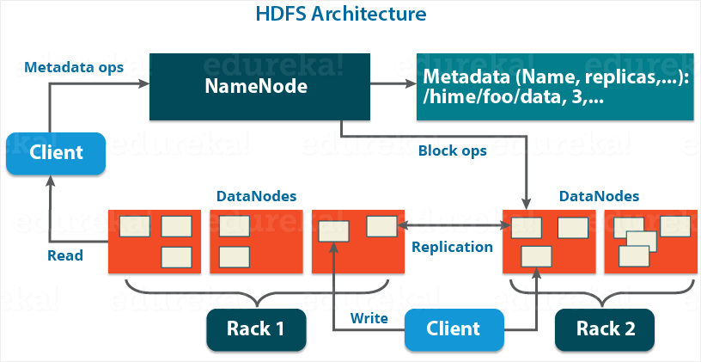
HDFS - Architecture
Notes:
Name Node
There is only single instance of this process runs on a cluster and that is on a master node
It is responsible for manage metadata about files distributed across the cluster
It manages information like location of file blocks across cluster and it’s permission
This process reads all the metadata from a file named fsimage and keeps it in memory
After this process is started, it updates metadata for newly added or removed files in RAM
It periodically writes the changes in one file called edits as edit logs
This process is a heart of HDFS, if it is down HDFS is not accessible any more
Secondary Name Node
For this also, only single instance of this process runs on a cluster
This process can run on a master node (for smaller clusters) or can run on a separate node (in larger clusters) depends on the size of the cluster
One misinterpretation from name is “This is a backup Name Node” but IT IS NOT!!!!!
It manages the metadata for the Name Node. In the sense, it reads the information written in edit logs (by Name Node) and creates an updated file of current cluster metadata
Than it transfers that file back to Name Node so that fsimage file can be updated
So, whenever Name Node daemon is restarted it can always find updated information in fsimage file
Data Node
There are many instances of this process running on various slave nodes(referred as Data nodes)
It is responsible for storing the individual file blocks on the slave nodes in Hadoop cluster
Based on the replication factor, a single block is replicated in multiple slave nodes(only if replication factor is > 1) to prevent the data loss
Whenever required, this process handles the access to a data block by communicating with Name Node
This process periodically sends heart bits to Name Node to make Name Node aware that slave process is running

Slide 23
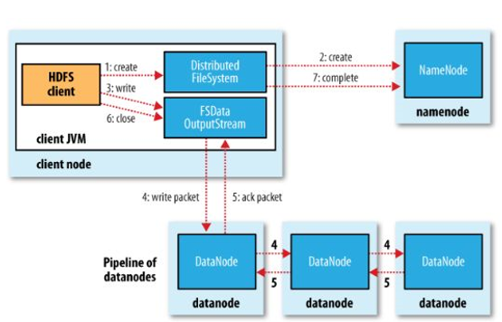
HDFS
Write data flow

Slide 24
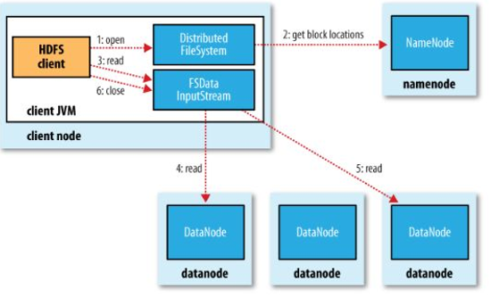
HDFS
Read data flow

Slide 25

Yarn

Slide 26
Yet Another Resource Manager
YARN
Que es?
Componentes
ResourceManager
Como funciona?
Arquitectura
Componentes y funciones
Concepto container
Problemas
Data Locality
NodeManager
ApplicationMaster
Scheduler
ApplicationManager
Proceso
Run job process
Yarn HA
Notes:
Resource Manager
This daemon process runs on master node (may run on the same machine as name node for smaller clusters)
It is responsible for getting job submitted from client and schedule it on cluster, monitoring running jobs on cluster and allocating proper resources on the slave node
It communicates with Node Manager daemon process on the slave node to track the resource utilization
It uses two other processes named Application Manager and Scheduler for MapReduce task and resource management
Scheduler
This daemon process resides on the Master Node (runs along with ResourceManager daemon )
Responsible for,
Scheduling the job execution as per submission request received by ResourceManager
Allocating resources to applications submitted to the cluster
Coordinating with ApplicationManager daemon and keeping track of resources of running applications
ApplicationManager
This daemon process resides on the Master Node (runs along with ResourceManager daemon )
Responsible for,
Helping Scheduler daemon to keeps track of running application by coordination
Accepting job submissions from client
Negotiating first container for executing application specific task with suitable ApplicationMaster on slave node
Node Manager
This daemon process runs on slave nodes (normally on HDFS Data node machines)
It is responsible for coordinating with Resource Manager for task scheduling and tracking the resource utilization on the slave node
It also reports the resource utilization back to the Resource Manager
It uses other daemon process like Application Master and Container for MapReduce task scheduling and execution on the slave node
ApplicationMaster
This daemon process runs on the slave node (along with the NodeManager daemon)
It is per application specific library works with NodeManager to execute the task
The instance of this daemon is per application, which means in case of multiple jobs submitted on cluster, it may have more than one instances of ApplicationMaster on slave nodes
Responsible for,
Negotiating suitable resource containers on slave node from ResourceManager
Working with one or multiple NodeManagers to monitor task execution on slave nodes
Container
It is considered to be a small unit of resources (like cpu, memory, disk) belong to the SlaveNode
Scheduler process running along with ResourceManager daemon allocates the resources as a container
At the beginning of a job execution with YARN, container allows ApplicationMaster process to make a use of some resources on any slave node on the cluster
Then ApplicationMaster manages the application execution across other containers on slave nodes of a YARN cluster

Slide 27
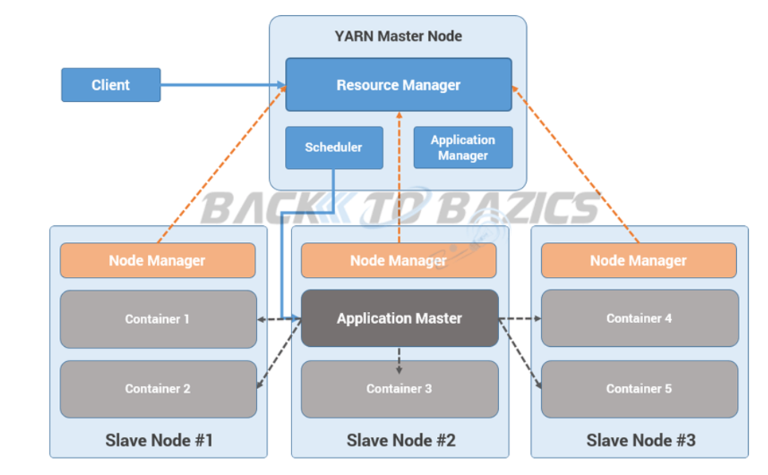
YARN
Run job process
Notes:
Step 1: Job/Application(which can be MapReduce, Java/Scala Application, DAG jobs like Apache Spark etc..) is submitted by the YARN client application to the ResourceManager daemon along with the command to start the ApplicationMaster on any container at NodeManager
Step 2: ApplicationManager process on Master Node validates the job submission request and hand it over to Scheduler process for resource allocation
Step 3: Scheduler process assigns a container for ApplicationMaster on one slave node
Step 4: NodeManager daemon starts the ApplicationMaster service within one of its container using the command mentioned in Step 1, hence ApplicationMaster is considered to be the first container of any application
Step 5: ApplicationMaster negotiates the other containers from ResourceManager by providing the details like location of data on slave nodes, required cpu, memory, cores etc..
Step 6: ReourceManager allocates the best suitable resources on slave nodes and responds to ApplicationMaster with node details and other details
Step 7: Then, ApplicationMaster send requests to NodeManagers on suggested slave nodes to start the containers
Step 8: ApplicationMaster than manages the resources of requested containers while job execution and notifies the ResourceManager when execution is completed
Step 9: NodeManagers periodically notify the ResourceManager with the current status of available resources on the node which information can be used by scheduler to schedule new application on the clusters
Step 10: In case of any failure of slave node ResourceManager will try to allocate new container on other best suitable node so that ApplicationMaster can complete the process using new container

Slide 28
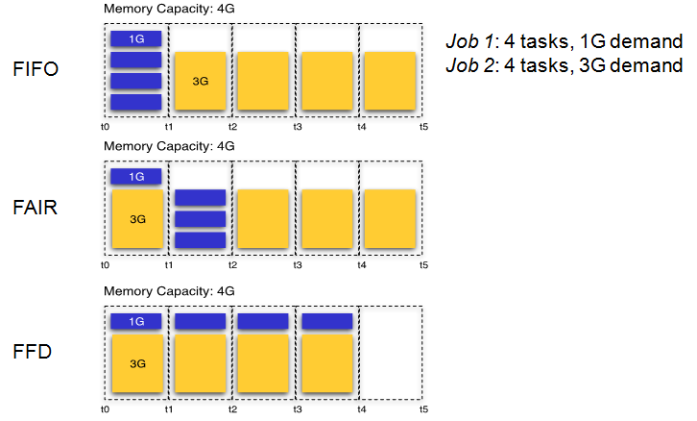
Schedulers
Notes:
Programación de tiempo[editar]
Por defecto Hadoop usa el método FIFO para programar la realización de trabajos desde una cola de trabajo. En la versión 0.19 el job scheduler (programador de trabajos) fue refactorizado fuera de Hadoop, lo cual añadió la habilidad de usar un programador alternativo.¹⁰​
Programador justo[editar]
El fair scheduler (programador justo o limpio) fue desarrollado por Facebook. El objetivo del programador es proporcionar rápida respuesta para trabajos pequeños y calidad de servicio (QOS, en sus siglas en inglés) para trabajos de producción. El fair scheduler se basa en 3 conceptos básicos:¹¹​
Los trabajos se agrupan en pools.
Cada pool tiene asignada una porción mínima garantizada.
El exceso de capacidad se distribuye entre trabajos.
Por defecto, los trabajos que están sin categorizar van a un pool por defecto. Las pools tienen que especificar el nº mínimo de slots de mapa, los reduce slots, y un límite en el número de trabajos ejecutándose.
Programador de capacidad[editar]
El programador de capacidad fue desarrollado por Yahoo. Soporta varias funciones similares a las del fair scheduler.¹²​
Los trabajos son presentados en las colas.
A las colas se le asigna una fracción de la capacidad total de recursos.
Los recursos libres se asignan a las colas más allá de su capacidad total.
Dentro de una cola, un trabajo con un alto nivel de prioridad tendrá acceso a los recursos de la cola.
No es posible la expropiación de recursos cuando se está ejecutando un trabajo.

Slide 29

Sqoop
Notes:
Apache Sqoop (“Sql-to-Hadoop”), es una herramienta diseñada para transferir de forma eficiente bulk data entre Hadoop y sistemas de almacenamiento con datos estructurados, como bases de datos relacionales. Algunas de sus características son:
Permite importar tablas individuales o bases de datos enteras a HDFS.
Genera clases Java que permiten interactuar con los datos importados.
Además, permite importar de las bases de datos SQL a Hive.
Think of Sqoop as a front-end loader for big data. Sqoop is a command-line interface that facilitates moving bulk data from Hadoop into relational databases and other structured data stores. Using Sqoop replaces the need to develop scripts to export and import data. One common use case is to move data from an enterprise data warehouse to a Hadoop cluster for ETL processing. Performing ETL on the commodity Hadoop cluster is resource efficient, while Sqoop provides a practical transfer method.

Slide 30
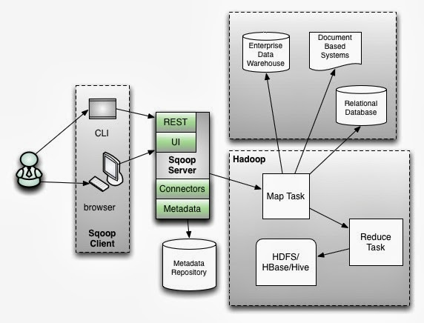
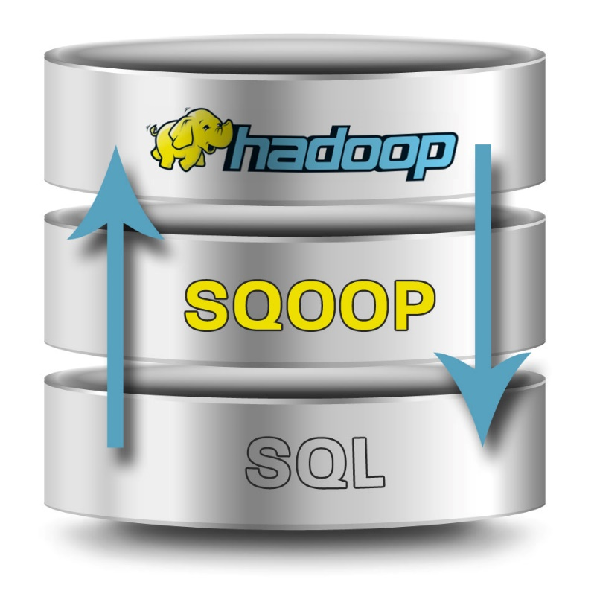
Sqoop

Slide 31
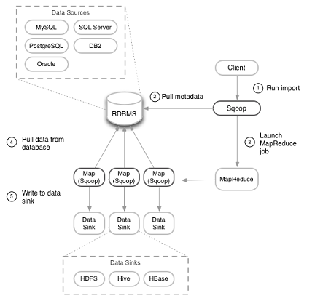
Sqoop
Import overview

Slide 32


Pig
Notes:
Apache Pig, inicialmente desarrollado por Yahoo, permite a los usuarios de Hadoop centrarse más en el análisis de los datos y menos en la creación de programas MapReduce. Para simplificar el análisis proporciona un lenguaje procedural de alto nivel. Su nombre viene de la siguiente analogía, al igual que los cerdos comen de todo, el lenguaje de programación Pig está pensado para poder trabajar en cualquier tipo de datos. Pig consta de dos componentes:
El lenguaje en si, llamado PigLatin.
El entorno de ejecución, donde los programas PigLatin se ejecutan.
Pig is a procedural language for developing parallel processing applications for large data sets in the Hadoop environment. Pig is an alternative to Java programming for MapReduce, and automatically generates MapReduce functions. Pig includes Pig Latin, which is a scripting language. Pig translates Pig Latin scripts into MapReduce, which can then run on YARN and process data in the HDFS cluster. Pig is popular because it automates some of the complexity in MapReduce development.
Pig is commonly used for complex use cases that require multiple data operations. It is more of a processing language than a query language. Pig helps develop applications that aggregate and sort data and supports multiple inputs and exports. It is highly customizable, because users can write their own functions using their preferred scripting language. Ruby, Python and even Java are all supported. Thus, Pig has been a popular option for developers that are familiar with those languages but not with MapReduce. However, SQL developers may find Hive easier to learn.

Slide 33
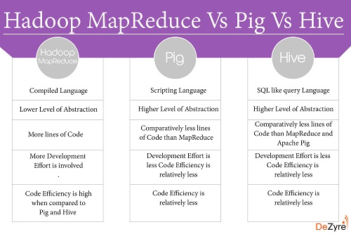

Slide 34
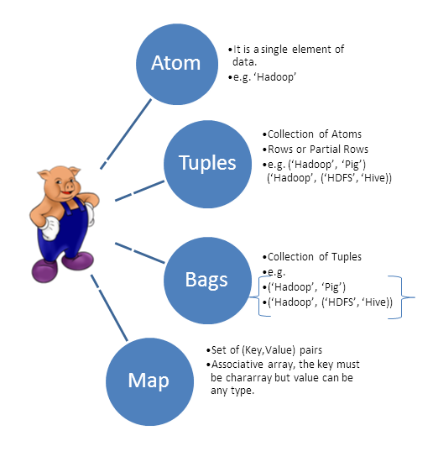
Pig
Data type

Slide 35
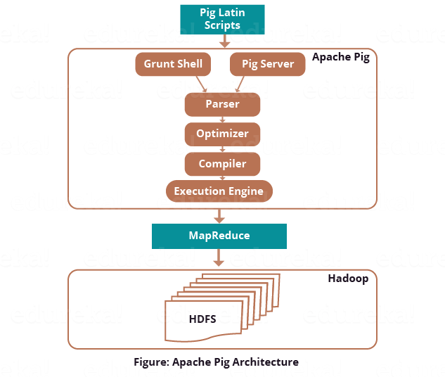
Pig

Slide 36
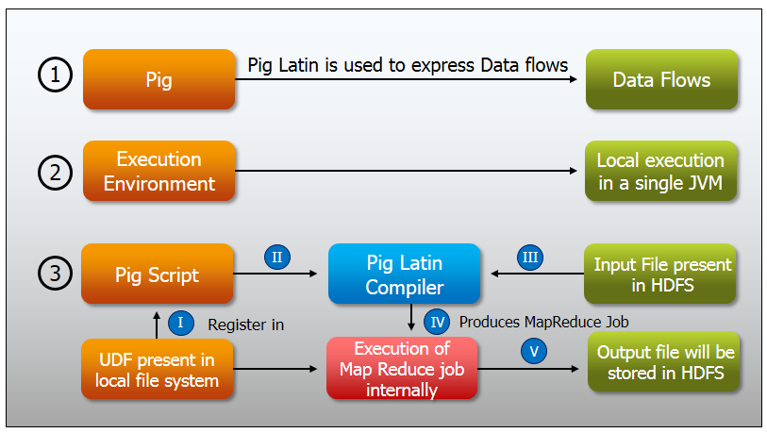
Pig

Slide 37

Hive
Notes:
Hive es un sistema de Data Warehouse para Hadoop que facilita el uso de la agregación de los datos, ad-hoc queries, y el análisis de grandes datasets almacenados en Hadoop. Hive proporciona métodos de consulta de los datos usando un lenguaje parecido al SQL, llamado HiveQL. Además permite de usar los tradicionales Map/Reduce cuando el rendimiento no es el correcto. Tiene interfaces JDBC/ODBC, por lo que empieza a funcionar su integración con herramientas de BI.
HCatalog – Helps data processing tools read and write data on the grid. It supports MapReduce and Pig.
WebHCat – Lets you use an HTTP/REST interface to run MapReduce, Yarn, Pig, and Hive jobs.
HiveQL – Hive’s query language intended as a way for SQL developers to easily work in Hadoop. It is similar to SQL and helps both structure and query data in distributed Hadoop clusters.
Hive queries can run from the Hive shell, JDBC, or ODBC. MapReduce (or an alternative) breaks down HiveQL statements for execution across the cluster.
Hive also allows MapReduce-compatible mapping and reduction software to perform more sophisticated functions. However, Hive does not allow row-level updates or support for real-time queries, and it is not intended for OLTP workloads.

Slide 38
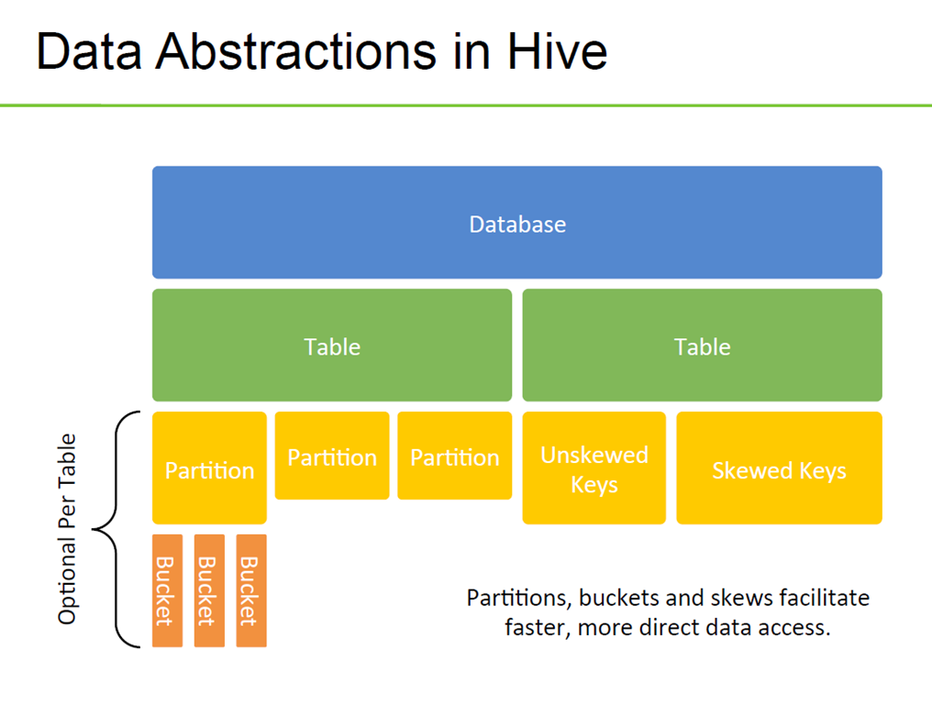
Notes:
Partitioned Tables
In Hive, tables are often partitioned. Partitions map to physical directories on the filesystem. Frequently, tables are partitioned by date-time as incoming data is loaded into Hive each day. Large deployments can have tens of thousands of partitions.
Using partitions can significantly improve performance if a query has a filter on the partitioned columns, which can prune partition scanning to one or a few partitions that match the filter criteria. Partition pruningoccurs directly when a partition key is present in the WHERE clause. Pruning occurs indirectly when the partition key is discovered during query processing. For example, after joining with a dimension table, the partition key might come from the dimension table.
Partitioned columns are not written into the main table because they are the same for the entire partition, so they are "virtual columns." However, to SQL queries, there is no difference
Bucketed Tables
Tables or partitions can be further divided into buckets, which are stored as files in the directory for the table or the directories of partitions if the table is partitioned. Bucketing can optimize Hive's scanning of a data set that is the target of repeated queries.
When buckets are used with Hive tables and partitions, a common challenge is to maintain query performance while workload or data scales up or down. For example, you could have an environment where picking 16 buckets to support 1000 users operates smoothly, but a spike in the number of users to 100,000 for a day or two could create problems if the buckets and partitions are not promptly tuned. Tuning the buckets is complicated by the fact that after you have constructed a table with buckets, the entire table containing the bucketed data must be reloaded to reduce, add, or eliminate buckets.
With Tez, you only need to deal with the buckets of the biggest table. If workload demands change rapidly, the buckets of the smaller tables dynamically change to complete table JOINs.

Slide 39
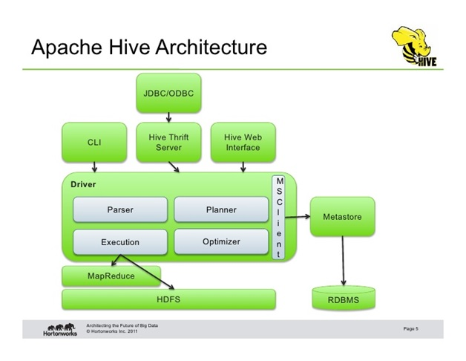
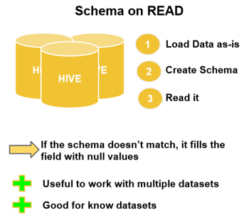
Hive

Slide 40
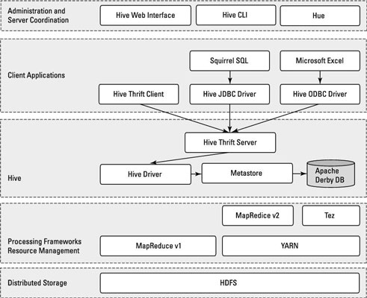
Hive

Slide 41

Spark
Notes:
Data sharing is slow in MapReduce due to replication, serialization, and disk IO. Most of the Hadoop applications, they spend more than 90% of the time doing HDFS read-write operations.
Recognizing this problem, researchers developed a specialized framework called Apache Spark. The key idea of spark is Resilient Distributed Datasets (RDD); it supports in-memory processing computation. This means, it stores the state of memory as an object across the jobs and the object is sharable between those jobs.
Spark is also popular because it supports SQL, which helps overcome a shortcoming in core Hadoop technology. The Spark programming environment works interactively with Scala, Python, and R shells. It has been used for data extract/transform/load (ETL) operations, stream processing, machine learning development and with the Apache GraphX API for graph computation and display.

Slide 42
Data Processing
Hadoop: Apache Hadoop provides batch processing. In fact, Hadoop was the first framework that created ripples in the open-source community. Google’s revelation about how they were working with vasts amounts of data helped Hadoop developers a great deal in creating new algorithms and component stack to improve access to large scale batch processing.
MapReduce is Hadoop's native batch processing engine. Several components or layers (like YARN, HDFS etc) in modern versions of Hadoop allow easy processing of batch data. Since MapReduce is about permanent storage, it stores data on disk, which means it can handle large datasets. MapReduce is scalable and has proved its efficacy to deal with tens of thousands of nodes. However, Hadoop’s data processing is slow as MapReduce operates in various sequential steps.
Spark: Apache Spark is a good fit for both batch processing and stream processing, meaning it’s a hybrid processing framework. Spark speeds up batch processing via in-memory computation and processing optimization. It’s a nice alternative for streaming workloads, interactive queries, and machine-based learning. Spark can also work with Hadoop and its modules. The real-time data processing capability makes Spark a top choice for big data analytics.
Resilient Distributed Dataset (RDD) allows Spark to transparently store data on memory, and send to disk only what’s important or needed. As a result, a lot of time that is spent on the disc read and write is saved.
Ease of Use
Spark is easier to use than Hadoop as it comes with user-friendly APIs for Scala (its native language), Java, Python, and Spark SQL. Hadoop, on the other hand, is written in Java, difficult to program and requires abstractions. Since Spark provides a way to perform streaming, batch processing and machine learning in the same cluster, users find it easy to simplify their infrastructure for data processing.
An interactive REPL (Read–eval–print loop) allows Spark users to get instant feedback for the commands. Although there is no interactive mode available with Hadoop MapReduce, tools like Pig and Hive make it easier for adopters to work with it.
Graph Processing
Hadoop: Most processing algorithms, like PageRank, perform multiple iterations over the same data. MapReduce reads data from the disk and after a particular iteration, it sends results to the HDFS and then again reads the data from the HDFS for next iteration. Such a process increases latency and makes graph processing slow.
In order to evaluate the score of a particular node, message passing needs to contain scores of neighboring nodes. And, these computations require messages from it neighbors, but MapReduce doesn’t have any mechanism for that. Although there are fast and scalable tools, like Pregel and GraphLab, for efficient graph processing algorithms, they are not suitable for complex multi-stage algorithms.
Spark: Spark comes with a graph computation library called GraphX to make things simple. In-memory computation coupled with in-built graph support allows the algorithm to perform much better than traditional MapReduce programs. Netty and Akka make it possible for Spark to distribute messages throughout the executors.

Slide 43
Fault Tolerance
Hadoop: Hadoop achieves fault tolerance through replication. MapReduce uses TaskTracker and JobTracker for fault tolerance. However, TaskTracker and JobTracker have been replaced in second version of MapReduce by Node Manager and ResourceManager/ApplicationMaster, respectively.
Spark: Spark uses RDD and various data storage models for fault tolerance by minimizing network I/O. In the event of partition loss of an RDD, the RDD rebuilds that partition through the information it already has. So, Spark does not use the replication concept for fault tolerance.
Security
Hadoop MapReduce has better security features than Spark. Hadoop supports Kerberos authentication, which is a good security feature but difficult to manage. Hadoop MapReduce can also integrate with Hadoop security projects, like Knox Gateway and Sentry. Third party vendors also allow organizations to use Active Directory Kerberos and LDAP for authentication. Hadoop’s Distributed File System is compatible with access control lists (ACLs) and a traditional file permissions model.
Spark’s security is currently in its infancy, offering only authentication support through shared secret (password authentication). However, organizations can run Spark on HDFS to take advantage of HDFS ACLs and file-level permissions.
Costs
Both Hadoop and Spark are open-source projects, therefore come for free. However, Spark uses large amounts of RAM to run everything in memory, and RAM is more expensive than harddisks. Hadoop is disk-bound, so saves the costs of buying expensive RAM, but requires more systems to distribute the disk I/O over multiple systems.
As far as costs are concerned, organizations need to look at their requirements. If it’s about processing large amounts of big data, Hadoop will be cheaper since hard disk space comes at a much lower rate than memory space.
Compatibility
Both Hadoop and Spark are compatible with each other. Spark can integrate with all the data sources and file formats that are supported by Hadoop. So, it’s not wrong to say that Spark’s compatibility to data types and data sources is similar to that of Hadoop MapReduce.
Both Hadoop and Spark are scalable. One may think of Spark as a better choice than Hadoop. However, MapReduce turns out to be a good choice for businesses that need huge datasets brought under control by commodity systems. Both frameworks are good in their own sense. Hadoop has its own file system that Spark lacks. And, Spark provides a way for real-time analytics that Hadoop does not posses.

Slide 44
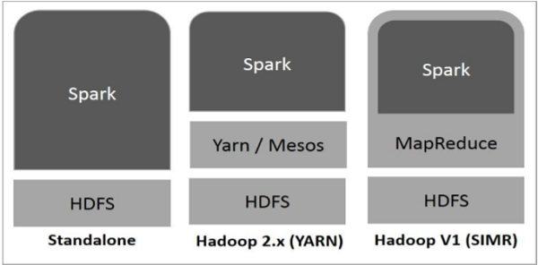
Spark deployment
Notes:
Standalone − Spark Standalone deployment means Spark occupies the place on top of HDFS(Hadoop Distributed File System) and space is allocated for HDFS, explicitly. Here, Spark and MapReduce will run side by side to cover all spark jobs on cluster.
Hadoop Yarn − Hadoop Yarn deployment means, simply, spark runs on Yarn without any pre-installation or root access required. It helps to integrate Spark into Hadoop ecosystem or Hadoop stack. It allows other components to run on top of stack.
Spark in MapReduce (SIMR) − Spark in MapReduce is used to launch spark job in addition to standalone deployment. With SIMR, user can start Spark and uses its shell without any administrative access.

Slide 45
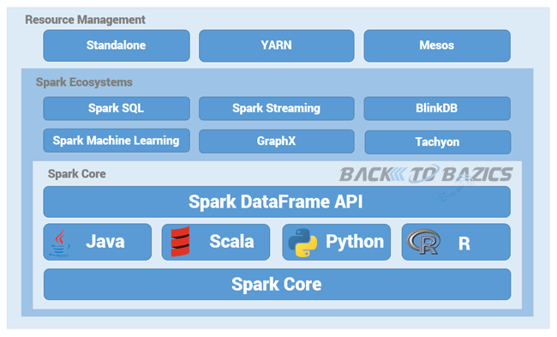
Spark
Notes:
Apache Spark Core
Spark Core is the underlying general execution engine for spark platform that all other functionality is built upon. It provides In-Memory computing and referencing datasets in external storage systems.
Spark SQL
Spark SQL is a component on top of Spark Core that introduces a new data abstraction called SchemaRDD, which provides support for structured and semi-structured data.
Spark Streaming
Spark Streaming leverages Spark Core's fast scheduling capability to perform streaming analytics. It ingests data in mini-batches and performs RDD (Resilient Distributed Datasets) transformations on those mini-batches of data.
MLlib (Machine Learning Library)
MLlib is a distributed machine learning framework above Spark because of the distributed memory-based Spark architecture. It is, according to benchmarks, done by the MLlib developers against the Alternating Least Squares (ALS) implementations. Spark MLlib is nine times as fast as the Hadoop disk-based version of Apache Mahout (before Mahout gained a Spark interface).
GraphX
GraphX is a distributed graph-processing framework on top of Spark. It provides an API for expressing graph computation that can model the user-defined graphs by using Pregel abstraction API. It also provides an optimized runtime for this abstraction.

Slide 46
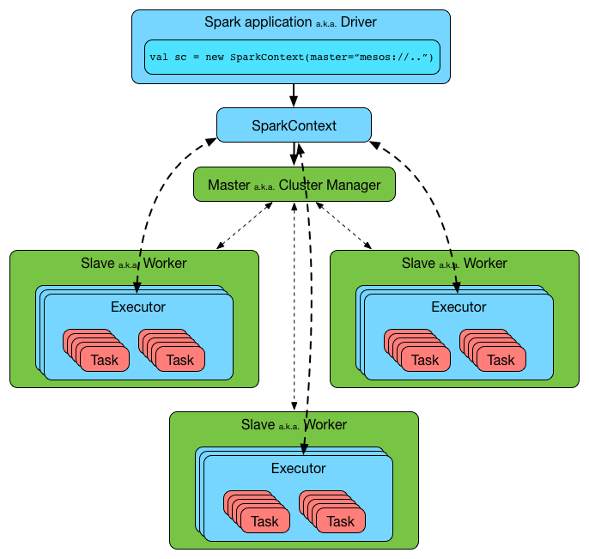
Spark

Slide 47
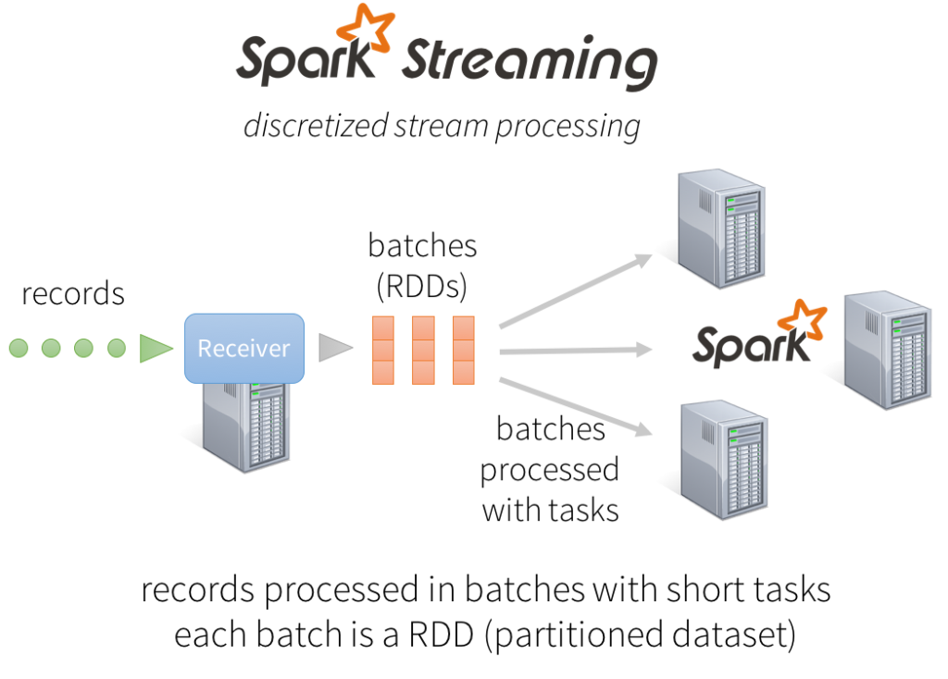

Slide 48
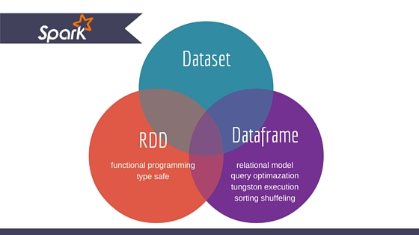
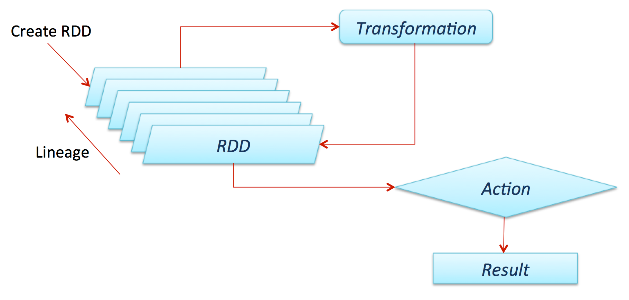
Spark Data
Notes:
There are two ways to create RDDs − parallelizing an existing collection in your driver program, or referencing a dataset in an external storage system, such as a shared file system, HDFS, HBase, or any data source offering a Hadoop Input Format.

Slide 49
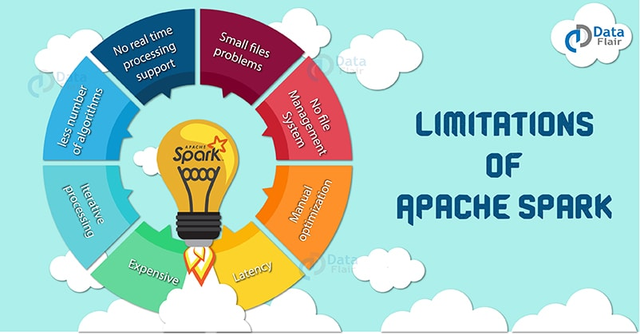
Spark

Slide 50

Lambda Architecture

Slide 51
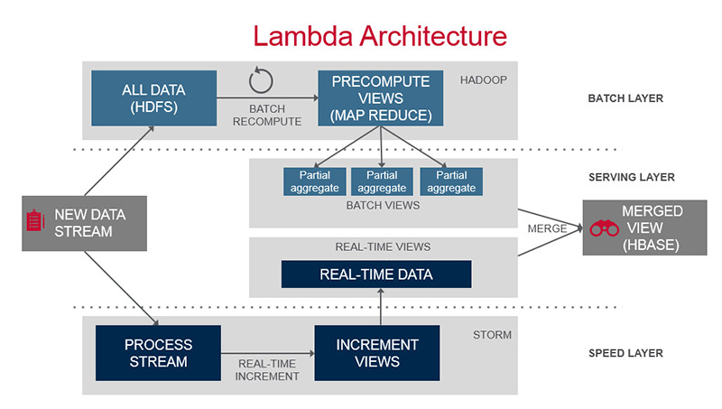
Lambda Architecture

Slide 52
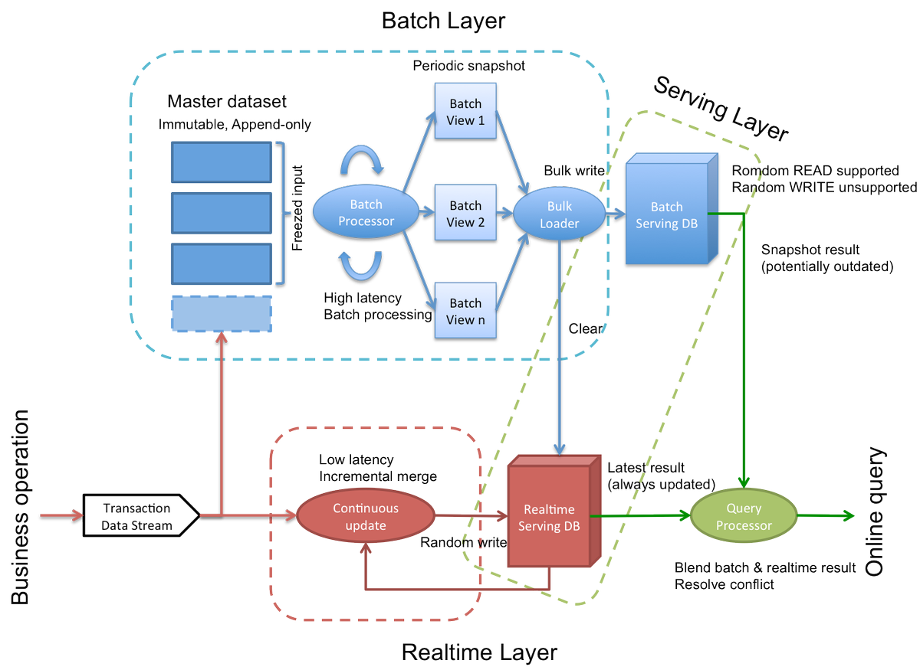

Slide 53
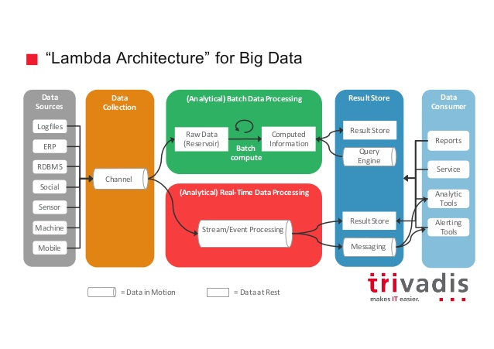

Slide 54

Kappa Architecture

Slide 55
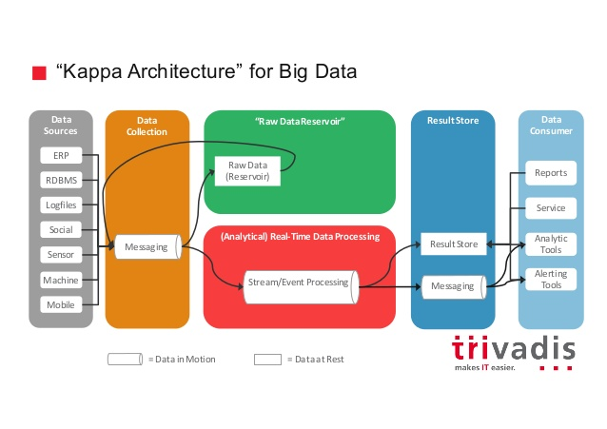

Slide 56

Flume
Notes:
Apache Flume es un sistema distribuido para capturar de forma eficiente, agregar y mover grandes cuantidades de datos log de diferentes orígenes (diferentes servidores) a un repositorio central, simplificando el proceso de recolectar estos datos para almacenarlos en Hadoop y poder analizarlos. Flume y Chukwa son proyectos parecidos, la principal diferencia es que Chukwa está pensado para ser usado en Batch.

Slide 57
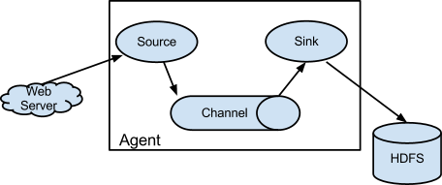
Flume

Slide 58
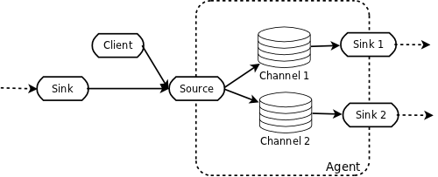
Flume pipeline

Slide 59
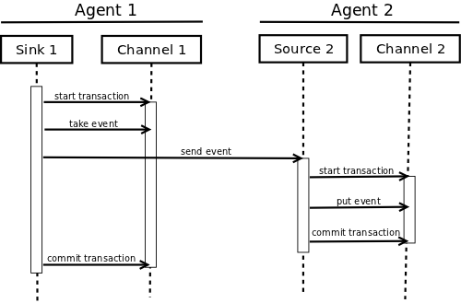
Flume – Agents transaction

Slide 60

Impala

Slide 61
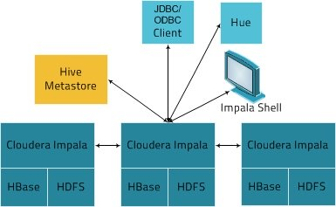
Impala

Slide 62

Cassandra

Slide 63
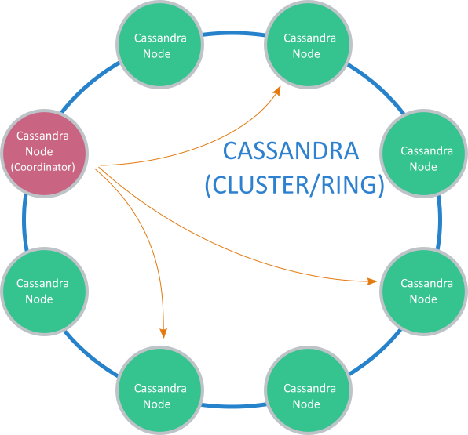
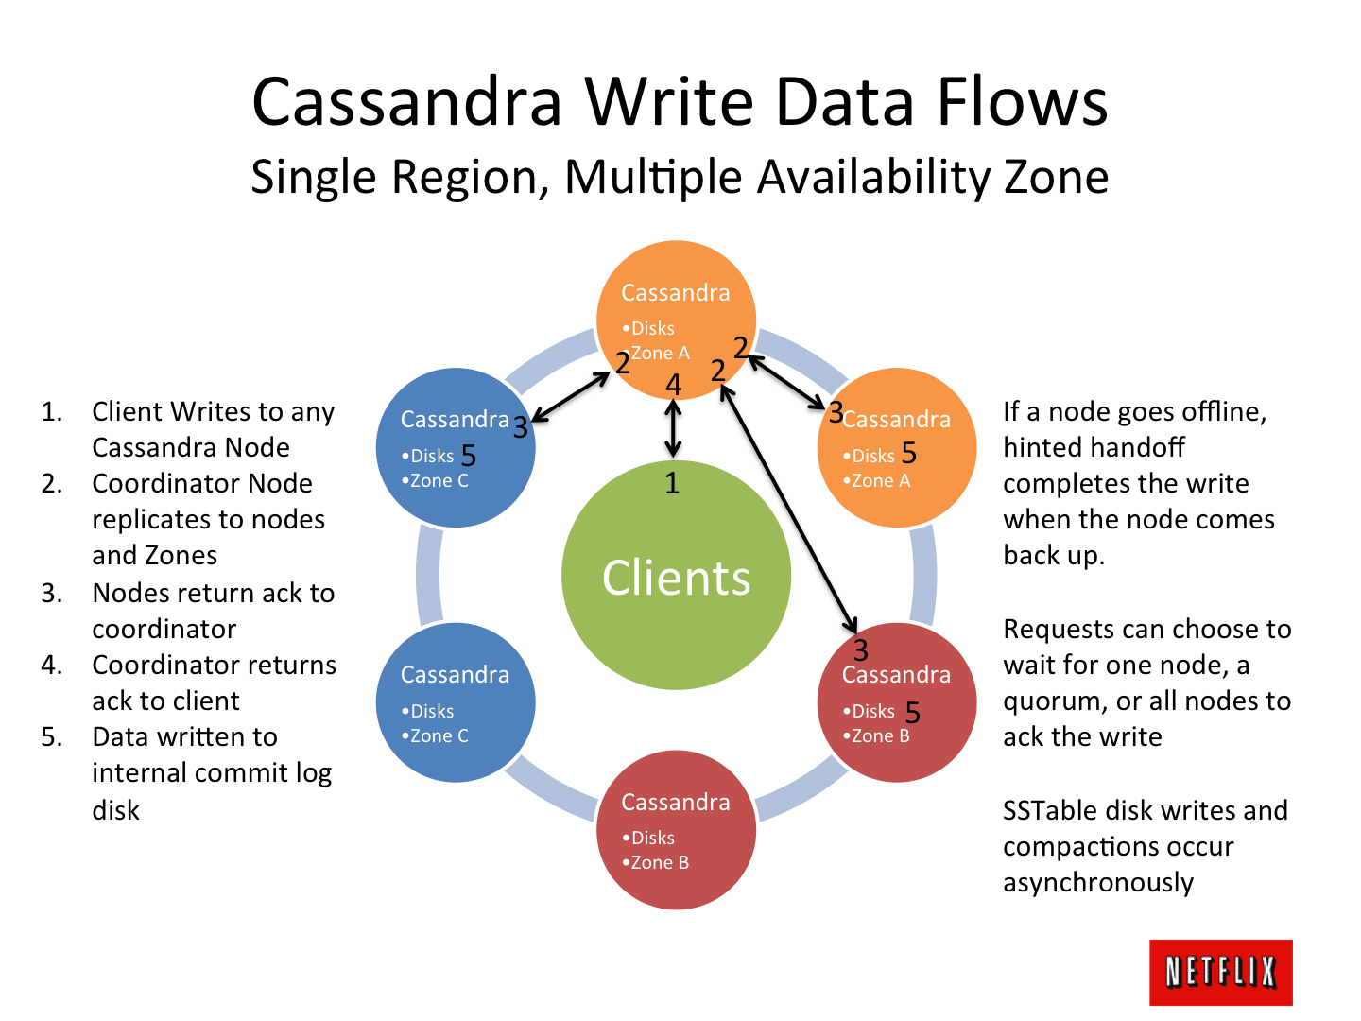

Slide 64
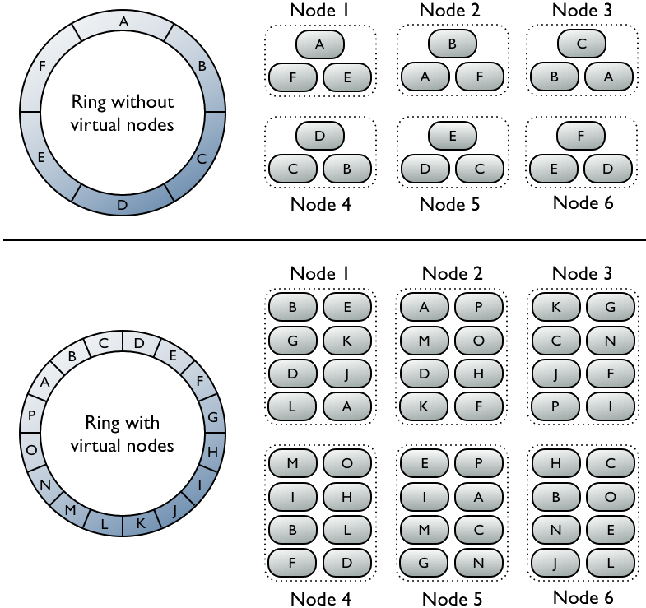

Slide 65

Tez

Slide 66
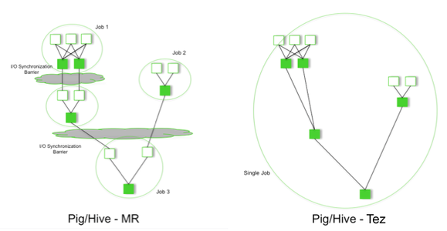
Tez

Slide 67

Mahout
Notes:
Apache Mahout, es un proyecto para crear aprendizaje automático y data mining usando Hadoop. Es decir, Mahout nos puede ayudar a descubrir patrones en grandes datasets. Tiene algoritmos de recomendación, clustering y clasificación.

Slide 68
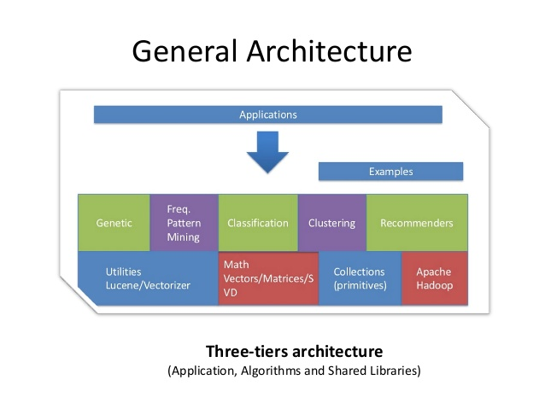
Mahout

Slide 69
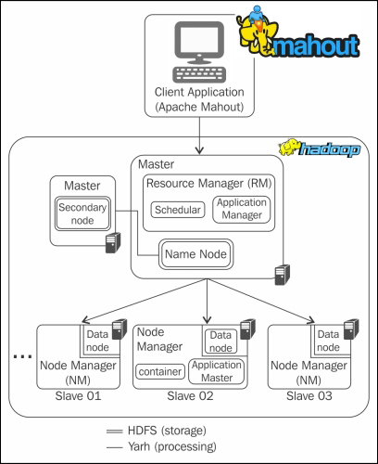

Slide 70

Flink

Slide 71


Slide 72


Slide 73



Slide 74

Apache Drill

Slide 75

Apache Drill

Slide 76

Apache Drill

Slide 77

MongoDB

Slide 78

MongoDB

Slide 79

MongoDB

Slide 80

Apache Ambari

Slide 81


Slide 82

Hue

Slide 83


Slide 84

Storm

Slide 85


Slide 86


Slide 87

HBase
Notes:
HBase, se trata de la base de datos de Hadoop. HBase es el componente de Hadoop a usar, cuando se requiere escrituras/lecturas en tiempo real y acceso aleatorio para grandes conjuntos de datos. Es una base de datos orientada a la columna, eso quiere decir que no sigue el esquema relacional. No admite SQL.
HBase is a scalable, distributed, NoSQL database that sits atop the HFDS. It was designed to store structured data in tables that could have billions of rows and millions of columns. It has been deployed to power historical searches through large data sets, especially when the desired data is contained within a large amount of unimportant or irrelevant data (also known as sparse data sets). It is also an underlying technology behind several large messaging applications, including Facebook’s.
HBase is not a relational database and wasn’t designed to support transactional and other real-time applications. It is accessible through a Java API and has ODBC and JDBC drivers. HBase does not support SQL queries, however there are several SQL support tools available from the Apache project and from software vendors. For example, Hive can be used to run SQL-like queries in HBase.

Slide 88

HBase

Slide 89

HBase

Slide 90

Hbase Cluster

Slide 91

Zookeeper
Notes:
Zookeeper es un proyecto de Apache que proporciona una infraestructura centralizada y de servicios que permiten la sincronización del cluster. ZooKeeper mantiene objetos comunes que se necesiten en grandes entornos de cluster. Algunos ejemplos de estos objetos son información de la configuración, jerarquía de nombres…

Slide 92


Slide 93

Kafka

Slide 94

Kafka

Slide 95

Oozie
Notes:
Oozie is the workflow scheduler that was developed as part of the Apache Hadoop project. It manages how workflows start and execute, and also controls the execution path. Oozie is a server-based Java web application that uses workflow definitions written in hPDL, which is an XML Process Definition Language similar to JBOSS JBPM jPDL. Oozie only supports specific workflow types, so other workload schedulers are commonly used instead of or in addition to Oozie in Hadoop environments.

Slide 96


Slide 97

Oozie workflow

Slide 98

Avro
Notes:
Avro, es un sistema de serialización de datos. En los proyectos en Hadoop, suele haber grandes cuantidades de datos, la serialización se usa para procesarlos y almacenar estos datos, de forma que el rendimiento en tiempo sea efectivo. Esta serialización puede ser en texto en plano, JSON, en formato binario. Con Avro podemos almacenar y leer los datos fácilmente desde diferentes lenguajes de programación. Está optimizado para minimizar el espacio en disco necesario para nuestros datos.

Slide 99

Avro
Object container file

Slide 100

Amazon Web Services

Slide 101


Slide 102


